Slide 1

Meet Up 2.0 Past Present Future of Web Technologies

Slide 2
How it all started ?

Slide 3
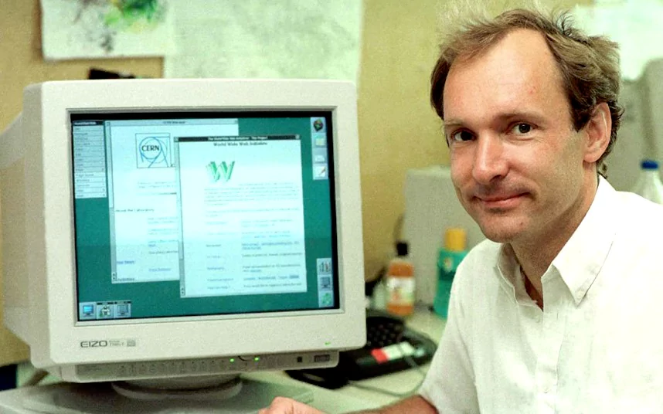
First Web Page
http://info.cern.ch/
HTML- Hyper Text Markup Language, 6th Aug 1991 in a lab in Swiss Alps.
In 1994 CHSS rose over HTML which now called as CSS, However HTML came back strongly in 1995 with improved version (HTML 2.0).
Tim Berners - Lee at CERN - 1989

Slide 4

JavaScript was developed in 1995 by Netscape and named as Mocha.
Later Changed to LiveScript and after handing over to SUN they named JavaScript.
1997 HTML 3.2 released which strongly helped to continue its existence supported by w3c.
1999 HTML 4 evolved to compete with competitors
Brendan Eich
father of JavaScript
Notes:
Automatic information-sharing between scientists in universities and institutes around the world.

Slide 5








Can you relate these ?
Netscape - 1993
First web browser
IE – 1996
First browser in OS
Google website - 1997
Revolution in Search engine
Wikipedia - 2001
Encyclopedia on web
Windows firewall – 2003
Web security
Facebook – 2006
Revolution in Social network
Apple – 2007
Web Apps
Chrome – 2008

Slide 6

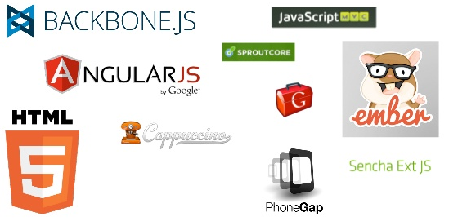


Client Side ….. Server Side ???
Client Side Frameworks
Server Side Frameworks

Slide 7
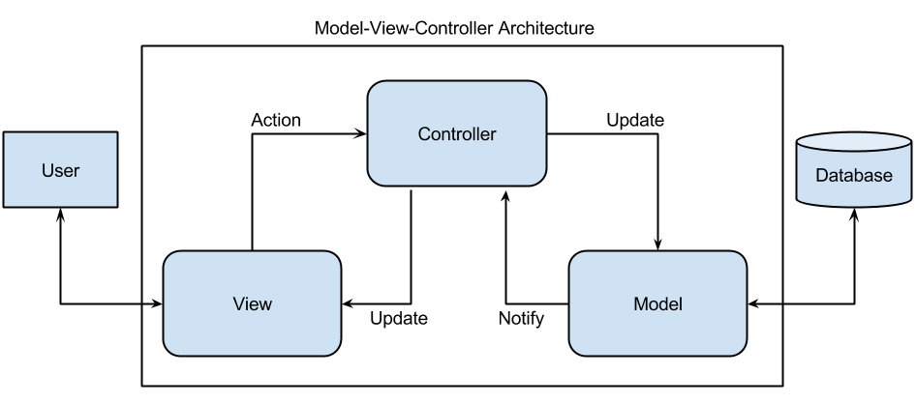
AngularJS
Misko Hevery, a Google employee, started to work with AngularJS in 2009.
Officially released in 2012.
Idea turned out very well, and the project is now officially supported by Google.
It Supports MVC Architecture Pattern.
Notes:
A model stores data that is retrieved according to commands from the controller and displayed in the view.
A view generates new output to the user based on changes in the model.
A controller can send commands to the model to update the model's state (e.g., editing a document). It can also send commands to its associated view to change the view's presentation of the model (e.g., scrolling through a document)

Slide 8

ExtJS
Pure JavaScript application framework for building cross platform RIA using techniques like Ajax, JSON, DHTML and DOM scripting.
Interoperability with jQuery and Prototype.
Industry’s most comprehensive collection of pre-integrated and tested high-performance UI components.
Pivot Grid, Data Visualization using D3, Customizable Built-In Themes, Layout Manager and Responsive Configs.

Slide 9
ExtJS
AngularJS
Enterprise Widget Framework
Scalable application architecture
Wide browser support
Customizable themes
Supports MVC & MVVM
Complete Cross Browser Compatible.
No built in support for automated testing but possible with external tools.
Core JavaScript Library
Assemble as you go
Modern Browsers only
No built-in themes
Supports MVW(MVC & MVVM)
Relies on jqLite / jQuery for the same
Supports Automated Testing
Karma facilitates Unit Testing
Protractor for end to end testing
Contd.

Slide 10
ExtJS
AngularJS
Cross platform native mobile applications or Hybrid apps development is possible with Cordova or Phonegap integration
Licensed and owned by Sencha
Heavy /Slow compared to other Frameworks
Supports Two way Databinding
Rich UI applications, Single page applications, With techniques like AJAX, DHTML and DOM scripting, it helps in building highly interactive web applications
Cross platform native mobile applications or Hybrid apps development is possible with Cordova or Phonegap integration
Open Source maintained by Google
Light Weight and Faster.
Supports Two way Databinding
Highly used for Single Page Applications

Slide 11
Node JS
By Ryan Dahl in 2009 later sponsored by Joyent.
JavaScript runtime built on Chrome's V8 JavaScript engine.
npm, largest ecosystem of open source libraries in the world.
Enables JavaScript to be used for server-side scripting, and runs scripts server-side to produce dynamic web page content before the page is sent to the user's web browser.
event-driven architecture capable of asynchronous I/O.
When combined with AngularJS forms a robust application.

Slide 12
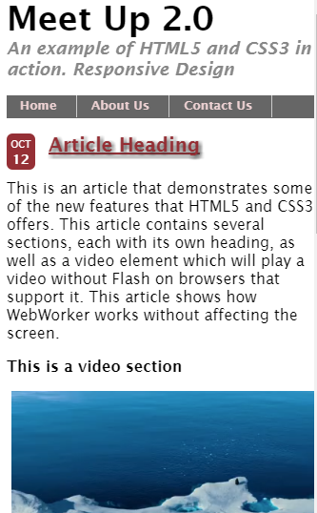
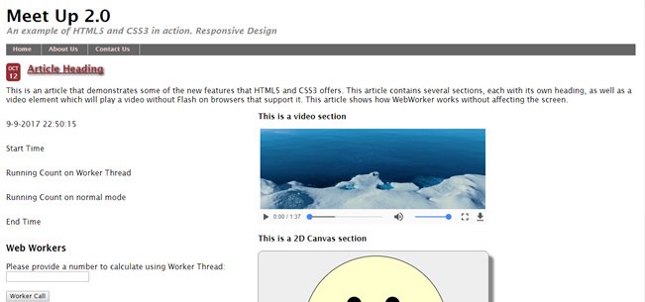
Responsive Web Designing
Mobile
Desktop

Slide 13


Web Technologies
AJAX
API
Ruby On Rails
Web Components
Notes:
From 2010 to today CSS and HTML 5 became an integral part of every web developer’s toolkit.
Drastic Usage of Mobile Web directed developers to create a page that supports for both Web and Mobile.
XHTML helped web technology to grow faster.
That’s how Responsive Web Design(RWD) Came in to light.
So many JavaScript frameworks which works as good client side scripting Language, and some act as Server Side scripting too.
For example Python: very easy to understand since it reads like a language rather than a program
Asynchronous JavaScript And XML -> Used to create Asynchronous Web Applications.
Application programming interface is a specification used to allow software components to communicate with each other.
Rails Framework place on top of the Ruby language and is leading the web in portable web application(Server Side Scripting Language)
New Frameworks &Languages coming up time to time.
Languages are growing easier to reduce the burden of Developers.
JavaScript API to handle queries.
Developing user own html tags and attributes.
IOT in all the things that are utilized in day to day life.

Slide 14
Lets go through a Demo RWD Web Workers WebRTC WebComponents Ruby on rails Angular two way data binding ExtJS two way databinding and latest Charts.
Notes:
http://bhcmwarcnv02/rvw/html5/index.html
https://webrtc.github.io/samples/
https://www.webcomponents.org/
https://www.webcomponents.org/element/LostInBrittany/granite-file-saver
https://www.tutorialspoint.com/execute_ruby_online.php
https://www.w3schools.com/angular/angular_intro.asp
http://examples.sencha.com/extjs/5.0.0/examples/kitchensink/#binding-two-way
http://www.angularjshub.com/code/examples/basics/02_TwoWayDataBinding_HTML/example-section-container.php?url=index.demo.php

Slide 15

Any Questions

Slide 16
Thank you all for joining the session

